Slide 1
AS91896(2.7) & AS91887(2.8) Burger Menu Combos
Thomas Xu

Slide 2
Burger Menu Combos
Link to your main (OneDrive) project folder:
[https://middletonschoolnzmy.sharepoint.com/:f:/g/personal/xut2_middleton_school_nz/Enii4MCCLIlDkVrJsVz0hRAB6lpRNIjeu53b8AvbJYsupA?email=P.Baker%40middleton.school.nz&e=dIz73Y]
Links to Trello board / project management tools: [https://trello.com/invite/b/FhtI14HZ/ATTIb9b8e9e667a0a7e4b64882e5e66f98628483FCFD/burger-menu-combos]
Link to final version of your program: [https://github.com/mgsthomasxu/pre-assessment/blob/main/final_version_burger_combo.py]

Slide 3
Explain relevant Implications:
Additional rows can be added by clicking in the last cell and then using the Tab key
Relevant implication | Describe the implication and give an example
Functionally | Features are about making sure the program works as expected. It should work for expected, borderline and unexpected situations. For example, if my program asks the user how many rounds they want, it should work fine for expected input (like "2") or boundary input (like "1"), but if the user enters something invalid (like "0" or "0.5") "), it should not crash or "a"
usability | Usability is about how early the end user can get the program to do what it's supposed to do. It addresses issues such as making instructions and error messages legible and easy for users to understand. It is important to minimize or eliminate any frustration.
aesthetic | Aesthetic is about the program’s overall appearance. A program which looks good because it includes well spaced instructions, prompts and ‘decoration’ around key messages is going to be more aesthetically pleasing than one which is composed of unspaced plain text
Notes:
Additional rows can be added by clicking in the last cell and then using the Tab key

Slide 4
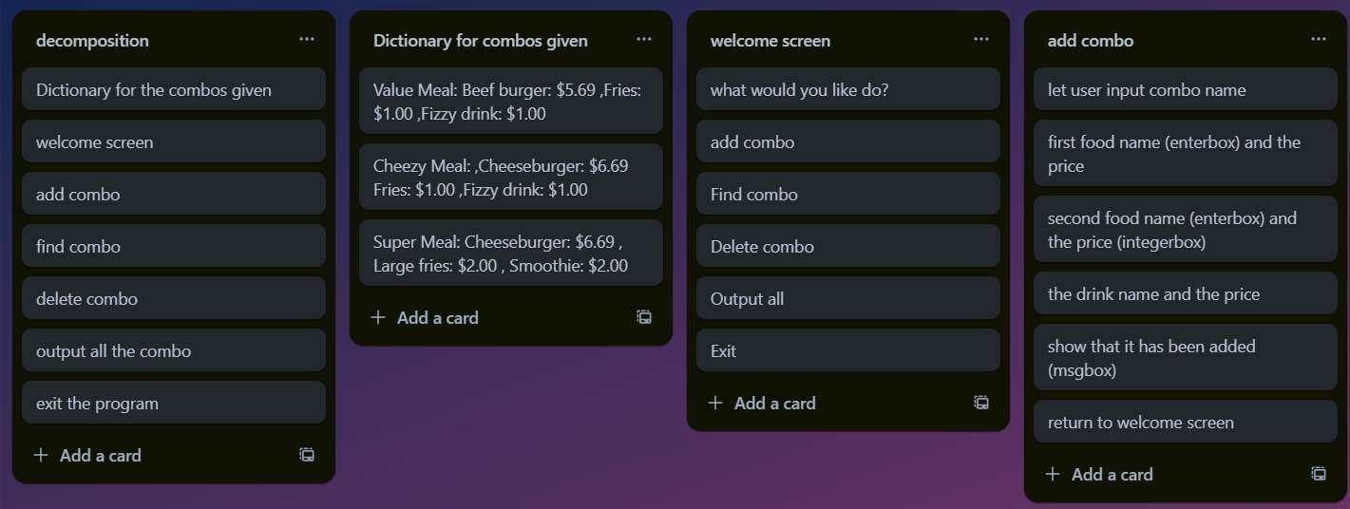
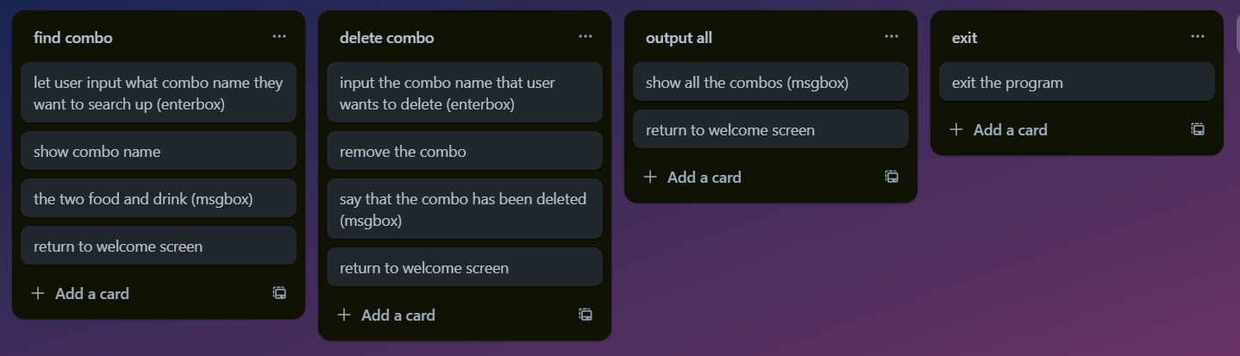
Decomposition: Burger Menu Combos
Notes:
Paste screenshots of your initial Trello board / task decomposition on this slide. If you have a long list, you might need to break it up into several slides.

Slide 5
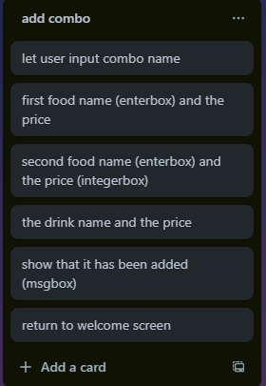
Add combo (Trello screenshot)

Slide 6
Add combo - Test Plan
Additional rows can be added by clicking in the last cell and then using the Tab key
Test Cases - input | Expected output
Enter the name of combo | Save name, Goes on to Enter item name
Enter item names of the combo | Goes on to Enter item price
Enter item price | If string, tell them to try again with an integer. Goes on to display combo, items, prices conforming
display combo, items, prices | loop until leave a blank and return main
combo save successful | Display {combo_name} added successfully!
Notes:
Additional rows can be added by clicking in the last cell and then using the Tab key

Slide 7
[Add combo]: Trialling
NOTE: Trialling needs to happen for at least 2 of your components but is not necessary for ALL components.
Trialling is not the same as testing. Trialling is about finding different ways of building the same component. Show evidence of your trialling here. Select one of your trials for further development and give reasons for your choice.
Notes:
NOTE: Trialling needs to happen for at least 2 of your components but is not necessary for ALL components.
Trialling is not the same as testing. Trialling is about finding different ways of building the same component. Show evidence of your trialling here. Select one of your trials for further development and give reasons for your choice.

Slide 8
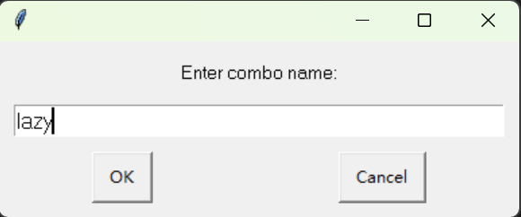
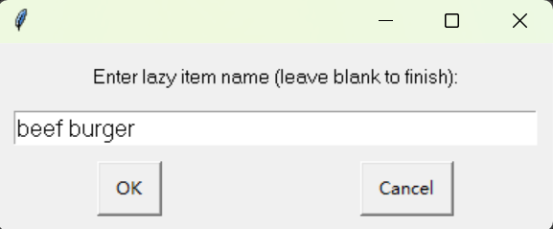
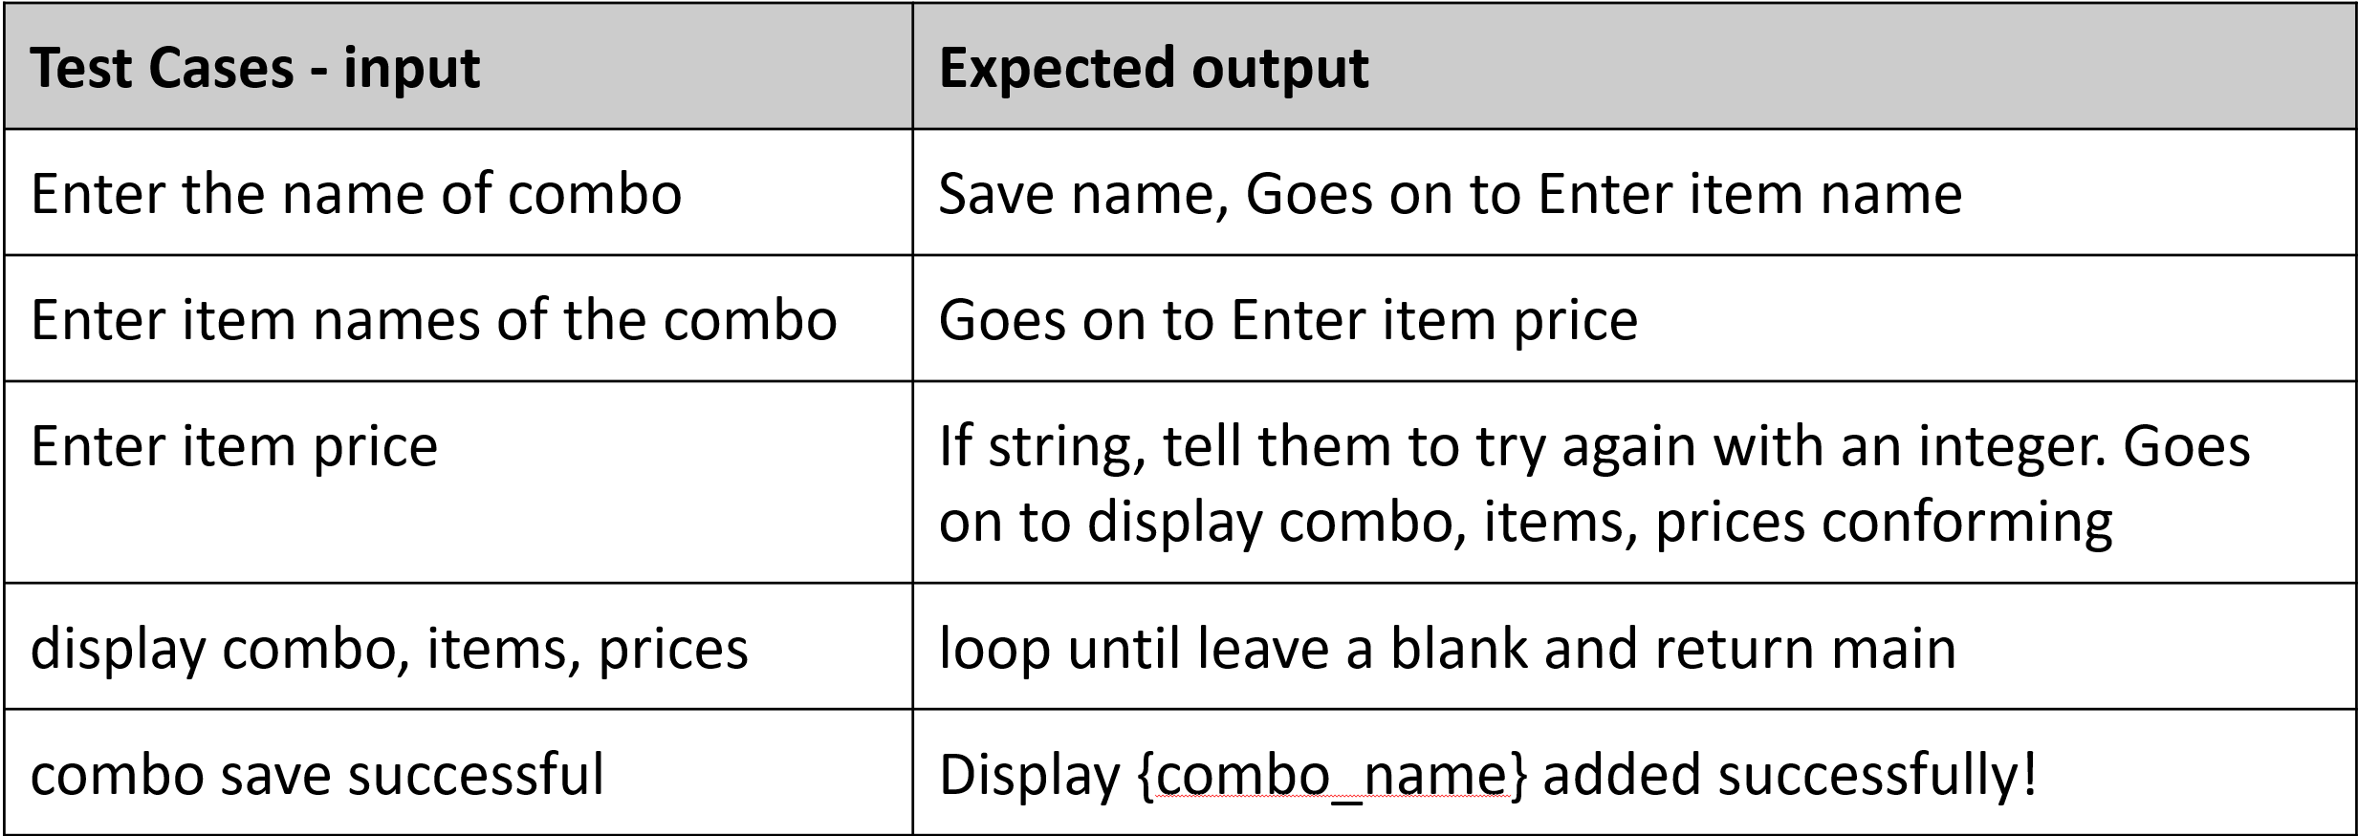
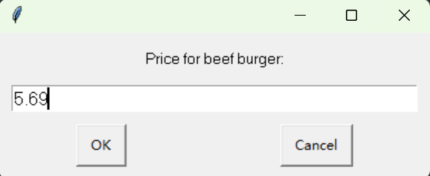
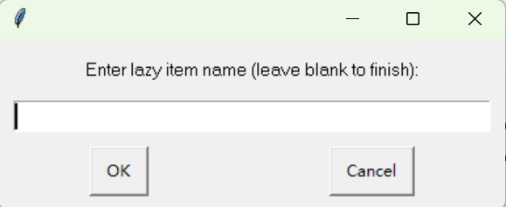
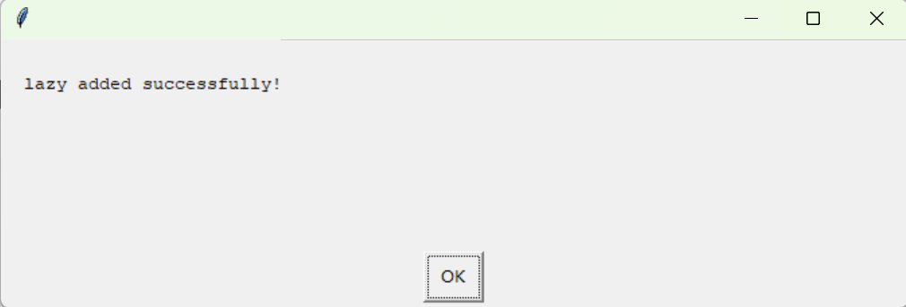
[Add Combo]: Testing
You must show the results of testing. For each component, include a screenshot proving it works. You can also include notes about each test.
Notes:
You must show the results of testing. For each component, include a screenshot proving it works. You can also include notes about each test.

Slide 9
Assembled Outcome Testing:
Show testing for your assembled outcome below. This should include a test plan followed by screenshot proof.
Notes:
Show testing for your assembled outcome below. This should include a test plan followed by screenshot proof.

Slide 10
Address relevant Implications:
Relevant implication | Explain how your final outcome addresses each implication
Functionally | This application helps you manage menu combos. You can add a combo by giving it a name and listing items with prices. You can also find a combo by its name and see the details. If you don't need a combo anymore, you can delete it. There's an option to show all combos, and when you're done, you can exit. These are the basic functions to manage menu combos.
usability | Using this application is easy because of the “easygui” library. You don't have to write any commands. Just click on buttons and enter information in pop-ups. The app gives clear instructions, and if you make a mistake, it shows an error message. You can do different tasks without restarting the app, which makes it user-friendly.
aesthetic | The application has a simple and clean design. The text is easy to read, and the pop-ups are clear. The language is simple, and the messages are helpful, so it's not confusing. The design isn't cluttered, which makes it pleasant to use. Overall, it looks nice and is easy to understand.

Slide 11
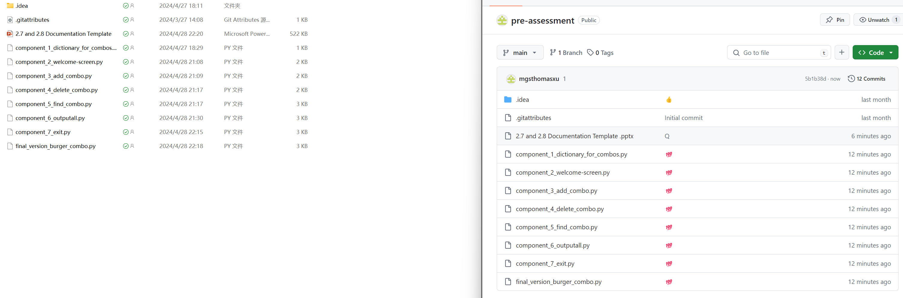
Version Control Evidence:
Your version control evidence should go here. This could be in the form of screenshots (both of your GitHub repository as well as your local project folder) as evidence of your incremental development.
Notes:
Your version control evidence should go here. This could be in the form of screenshots (both of your GitHub repository as well as your local project folder) as evidence of your incremental development.

Slide 12
Final Discussion:
Discuss how the information from planning, testing and trialling of components assisted in the development of a high-quality outcome.
Notes:
Discuss how the information from planning, testing and trialling of components assisted in the development of a high-quality outcome.

